Slide 1
Harvard FinTech Online short course
Capstone Project M6 U4
Topic 2 - Acquiring BanQu
Prepared by:
Wade Meadows
wade.meadows@gmail.com
443-827-2109
July 25, 2023

Slide 2
Assessing the Potential Acquisition of BanQu by Amazon
Stay Independent
Limited Growth
Status Quo
The future path:
BanQu
Sell to Amazon
Unlimited access to capital
Liquidity for initial investors
Immediate scale

Slide 3
Using blockchain, BanQu delivers supply chain compliance software that collects audit proof procurement and sustainability data across the value chain.
BanQu functions:
Proof of Quality
Auditable records
Verified payments
Real time reporting
Why blockchain:
Decentralized record keeping
Immutability of information
Barriers to Scale:
Cost of data storage
Data security
Distribution constraints
Global reach
Limited customer base
Capital
Sources: banqu.co website

Slide 4

A Proposal for Amazon to acquire BanQu
Unlimited Capital
Allows “plug and play” into other Amazon companies
Both companies aligned with “sustainability” and “verifiable” supply chains
Amazon storefronts provide distribution for BanQu first mile and last mile clients
Amazon Web Services can deliver better, cost effective data management
Strengthens the Company
With Whole Foods sustainable sourcing
With Amazon Storefronts
With Amazon Pay
With Zappos.com
With Amazon Cash
Partnerships
Career growth due to increased scale
Career opportunities across subsidiaries
Increased shareholder return
Capital access provides shareholder liquidity
Customers benefit from sustainable and verifiable sourced products
Opportunity for Stakeholders

Slide 5
A glimpse of how the Amazon Eco-System can assist
BanQu
Amazon Marketplace
Whole Foods
Amazon Pay
Amazon Cash
AWS

Slide 6
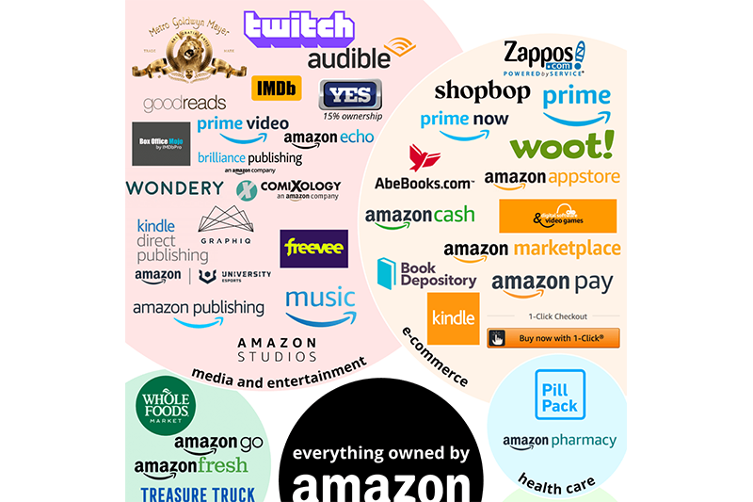
Businesses Owned by Amazon: A Tremendous Collaboration Opportunity
Source: Amazon website

Slide 7
Current challenges to BanQu’s growth as an independent company:
Capital constrained
Difficult to attract associate talent
Global name recognition
Only 40 employees and $6MM in revenue
Current Opportunities for BanQu to remain a independent company:
Culture of innovation
Driven by its mission “lift 100 million people out of extreme poverty”.
Already in 57 countries.
Ability to continue to pursue its mission on its timeline.

Slide 8
BanQu’s growth opportunities if acquired:
Unlimited growth due to Amazon’s global reach and infrastructure.
Efficiency of technology – the backbone is in place
Amazon has already scaled most of its businesses and has know how.
BanQu’s products and services are needed in the Amazon supply chain.
Amazon a trusted name and experienced acquirer of businesses.
Amazon Cash and Amazon Pay give real benefits to BanQu’s first mile laborers.
BanQu’s challenges if acquired by Amazon:
Risk of culture loss.
Certain customers value independence.
Certain customers may seek competitor solutions because of Amazon size.
Integration risk – talent loss at BanQu.
Become a small fish in a vast ocean.

Slide 9
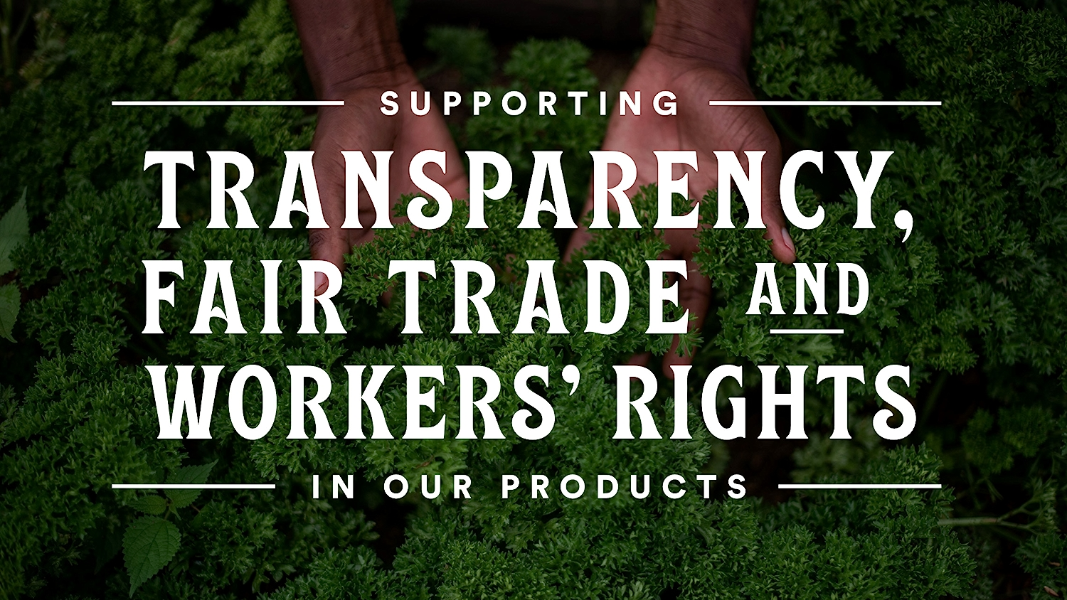

Example: BanQu immediate collaboration with Whole Foods Market’s Responsible Sourcing Program
Traceable from Source to Store
Supply chain transparency is one of the many ways we work to ensure that our customers feel good about what they’re putting in their baskets. We work to know what is happening in our supply chain and share this knowledge with our team members and customers.
We have traceability programs in place to track 365 by Whole Foods Market brand products back to the manufacturer or farm of origin, and we require fair and safe working conditions for the men and women who grow the food we sell — both inside and outside the U.S. We also have traceability programs for our Meat and Seafood departments, eggs in our dairy cases, canned tuna and more.
Source- Whole Foods website

Slide 10
What does a successful integration look like?
A strategy officer is named to lead integration, one with a successful track record of integrating prior Amazon acquisitions.
A comprehensive analysis is done of BanQu’s customer base. Identifying customer overlap.
A technology integration lead is appointed to take the best of each platform and lay out a plan for adoption of the strongest.
Amazon human resources takes in the 40’ish BanQu employees and integrates them into existing payroll and employee benefit programs, honouring titles and start dates of BanQu’s employees.
Marketing develops a comprehensive plan on communicating BanQu’s platform across the multiple subsidiaries and client base.
Finance takes over all payables, receivables, vendor management and incorporates into existing Amazon financial processes, delivering control, oversight and eliminating costs.

Slide 11
Summary
Both firm’s similar missions and commitment to sustainable and ethical sourcing continue to thrive.
An acquisition by Amazon gives liquidity to VC investors and allows BanQu to scale.
The Amazon resources give BanQu the growth tools – better technology, cloud computing and storage (via AWS) and capital.
The global reach of Amazon gives BanQu better name recognition and validation.
Associates have more career choices and strong employee benefits.
Amazon gets a “plug-n-play” blockchain technology platform to use, offer and distribute across its entire eco-system.

